Slide 1

Infosys Springboard Virtual Internship 6.0
Completion Report
Name
Batch
Duration
Lakshita Setia
Batch Number: 2
8 Weeks

Slide 2
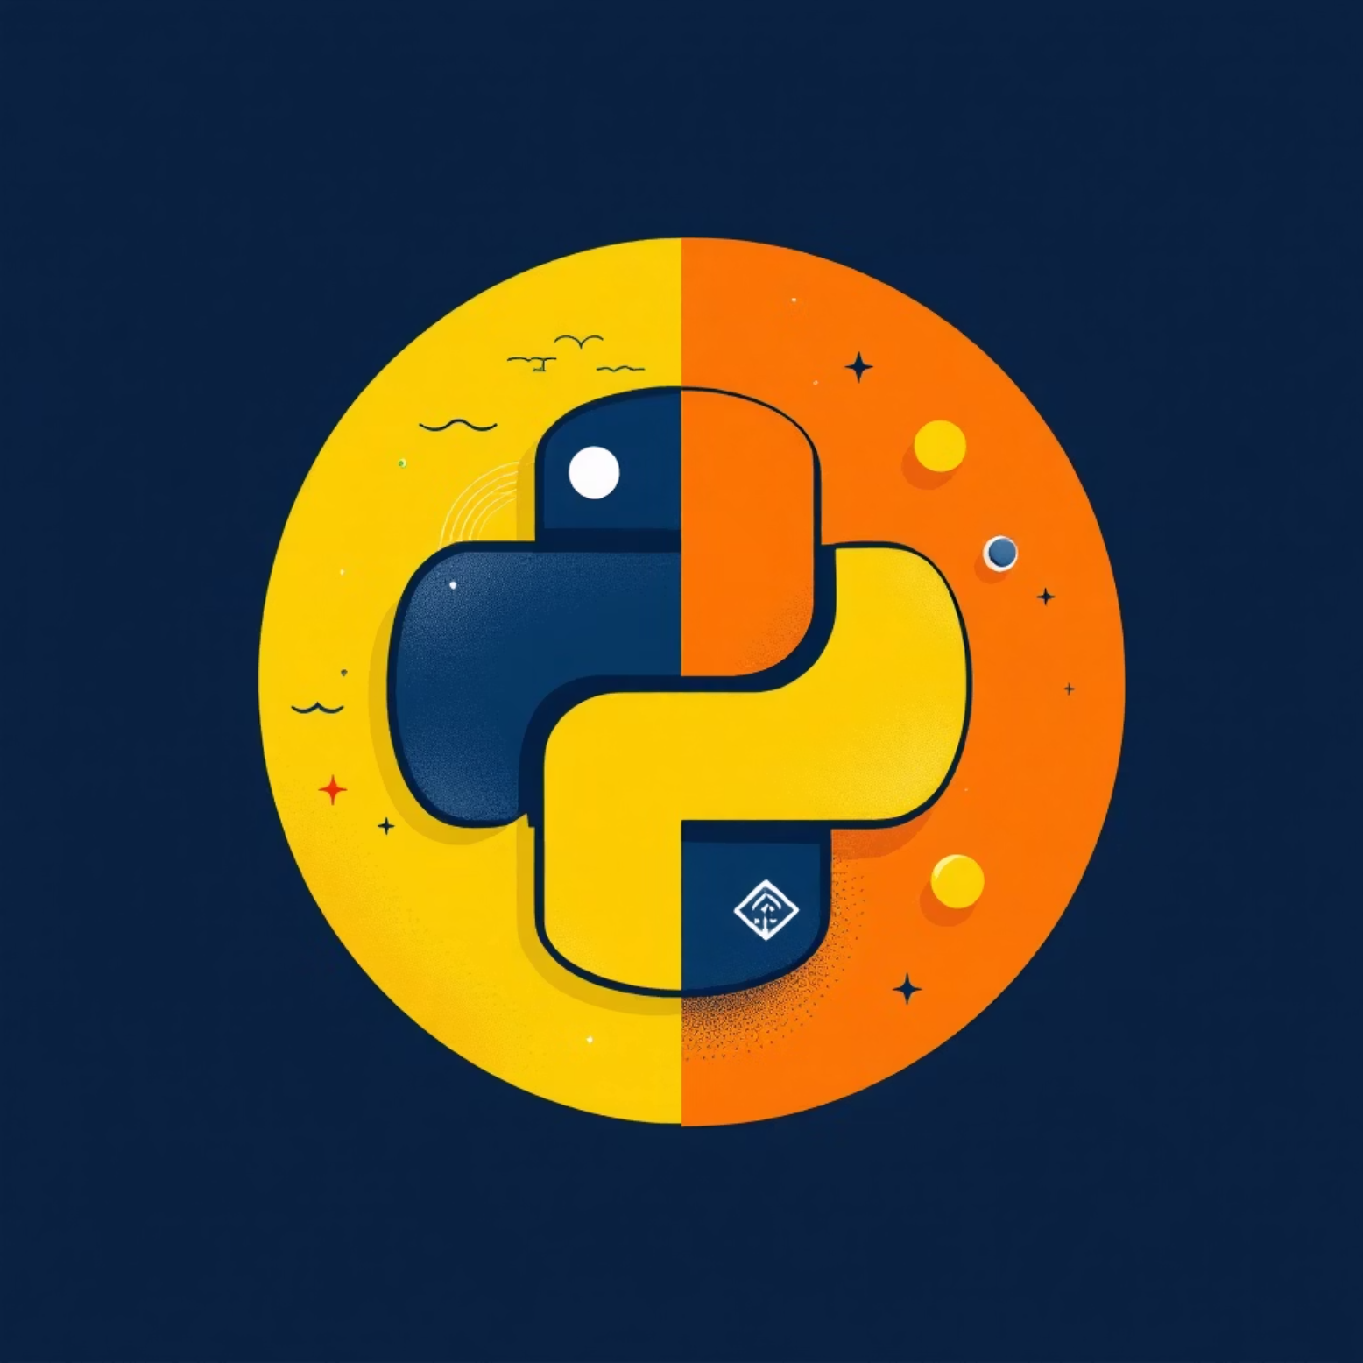
Project Title & Objective
Project Title
Core Objective
TextMorph
Develop an AI-driven application to automatically summarize and paraphrase long textual content efficiently.
Advanced Text Summarization and Paraphrasing
Aimed to combine modern NLP models with an interactive Streamlit interface to help users condense and rephrase large volumes of text without losing context.

Slide 3


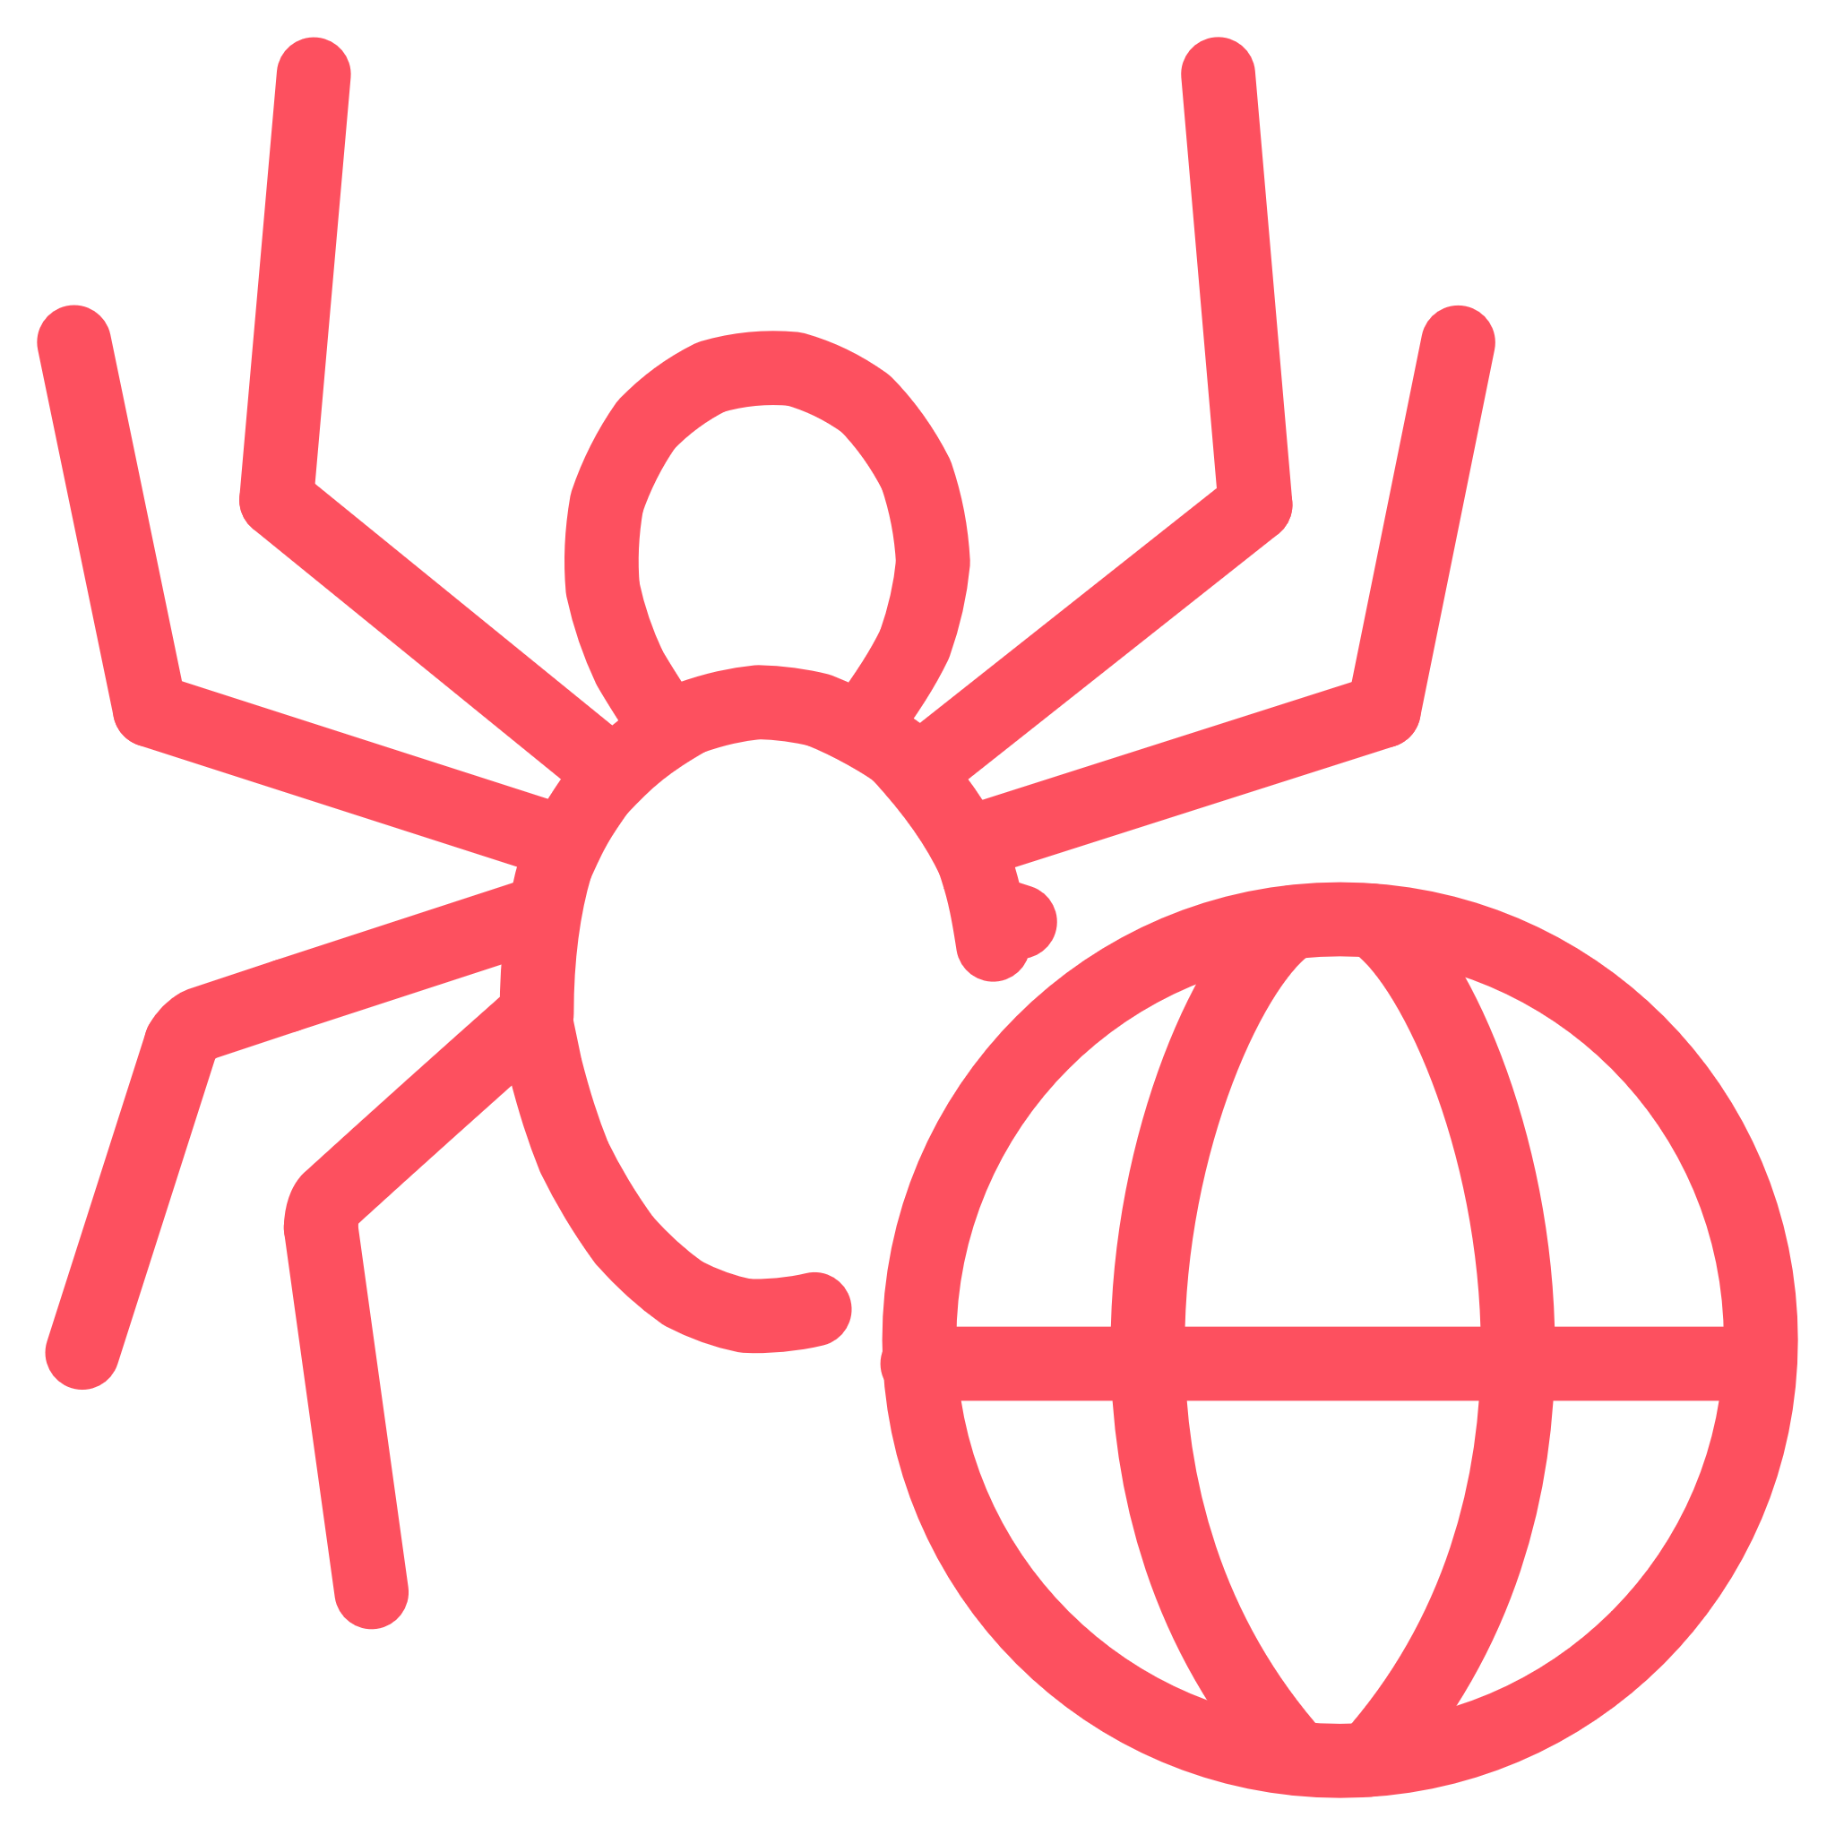
TextMorph: System Overview
The application integrates advanced NLP models and a user-friendly web interface, focusing on two major functionalities: Summarization and Paraphrasing.
Summarization Module
Paraphrasing Module
Streamlit Front-End
Condenses long text using a transformer-based pipeline (BART/T5).
Rewrites input text while preserving original meaning (using GROQ API).
Provides an easy interface for users to input, view, copy, and download results.

Slide 4
Functional Workflow & Technology Stack
Workflow Steps
Tech Stack
01
Language: Python
Input Processing
Framework: Streamlit
Users paste text or upload a document.
Libraries: Transformers, Hugging Face, dotenv
Models: BART, T5
02
Version Control: Git & GitHub
Summarization
Text is tokenized, truncated, and processed by Hugging Face models (BART/T5).
03
Paraphrasing
Will utilize pre-trained models to produce alternate rewordings.
04
Output Display
Generated results are displayed on the dashboard for copying or downloading.

Slide 5
Project Timeline and Milestones
The 8-week internship followed a structured timeline, progressing from setup to final submission.
Week 1
1
Project setup, environment creation, repo initialization.
2
Week 2-3
BART summarizer implemented. Streamlit UI added and input-output workflow tested.
Week 4-5
3
Paraphrasing research and partial integration. Secure Git config added.
4
Week 6-7
UI enhancements, output export features added. Functional testing and debugging completed.
Week 8
5
Documentation, final report, and GitHub upload completed.

Slide 6


Execution Phases: Development Details
Phase 1: Environment Setup
Phase 2: Summarization and Paraphrasing
Created virtual environment, installed dependencies, and implemented .env for secure API token storage.
Implemented Hugging Face Transformers (BART/T5) for abstractive and extractive summaries, including token length control.
Phase 3: Streamlit App
Phase 4: Testing & Docs
Built an interactive UI with text input, file upload, and download features in a clean two-tab layout.
Tested summarization accuracy, verified GitHub commits, and documented all modules with README.md.

Slide 7
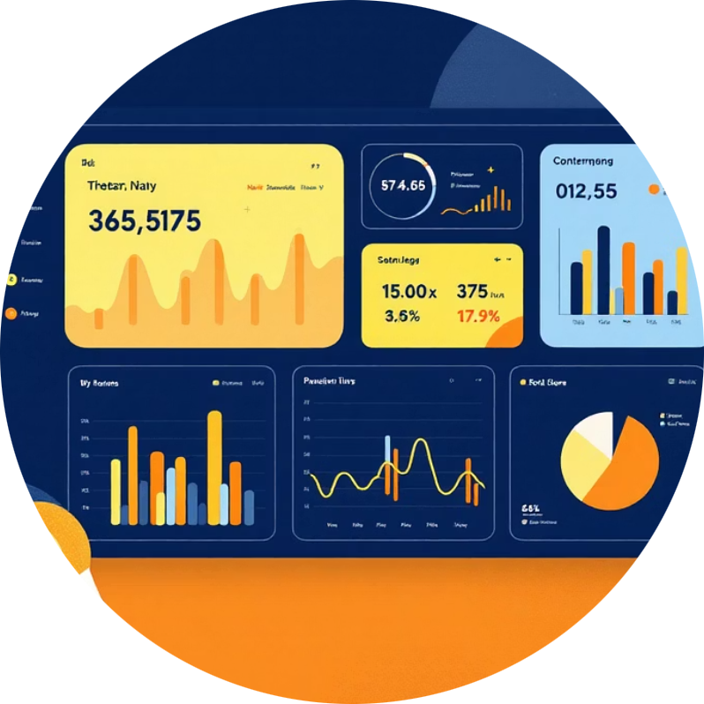
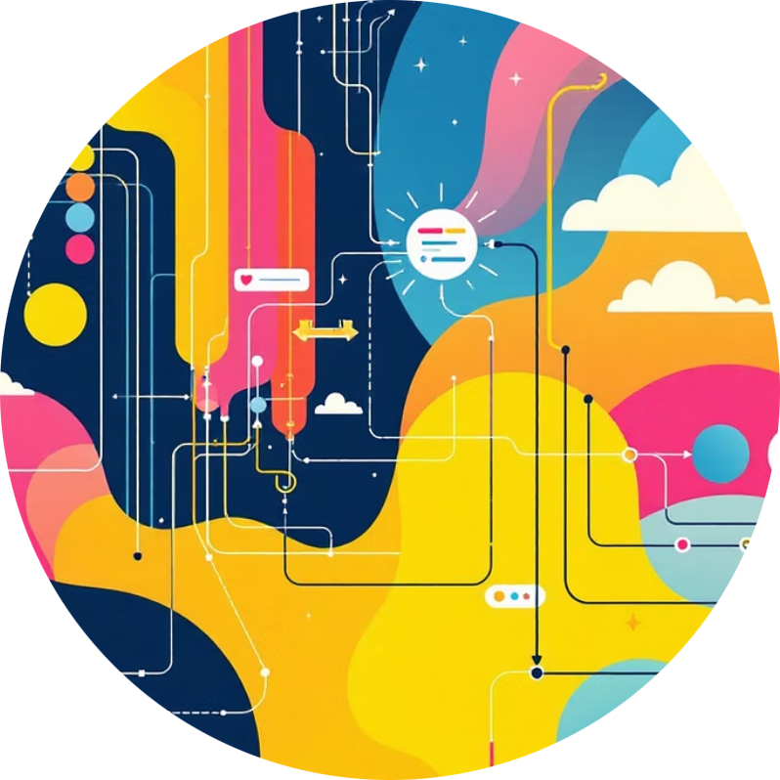
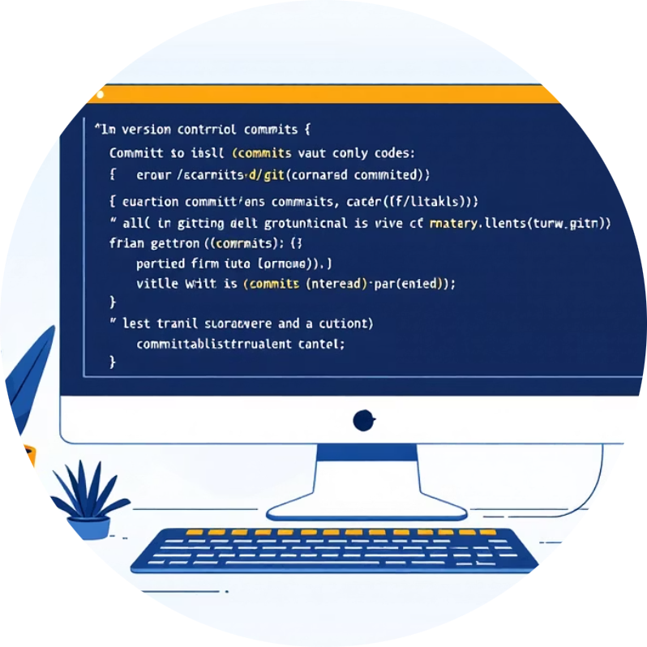
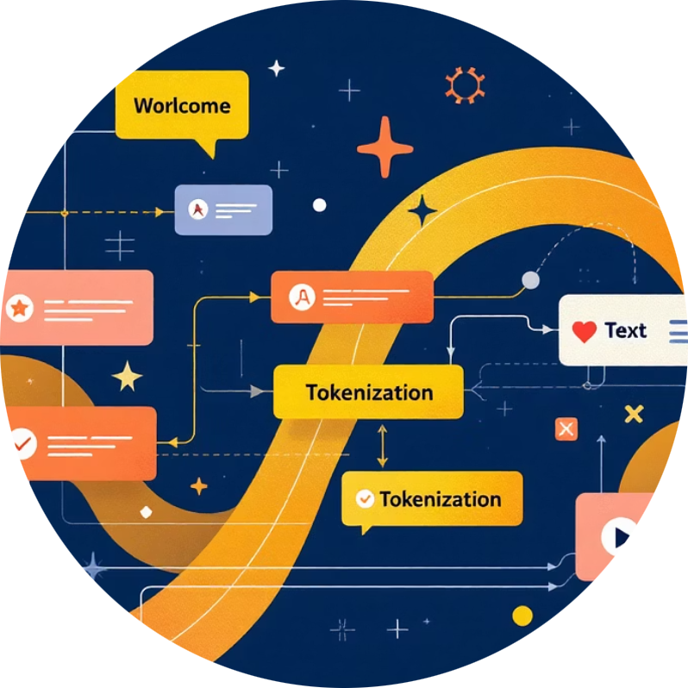
Technical Learnings Acquired
Streamlit Development
Hugging Face Models
Version Control & Git
Advanced Text Processing
Built end-to-end interactive web apps, managed session state, and optimized performance with caching.
Gained strong understanding of BART/T5 models, fine-tuning parameters (beam search), and using the inference API.
Developed hands-on experience with systematic version control, resolving conflicts, and maintaining clean commit histories.
Learned text cleaning, tokenization, and splitting long documents into overlapping chunks to improve model accuracy.

